Slide 1


Topic #7
May & June 2012 Recruiting Plan
Recruit 70 “Best Fit” Consulting Employees
Build out a Marketing team dedicated to recruiting
Formalize training program for new recruiters
Build out fully functioning offshore recruiting team
Implement call quality feedback loops
Coach and Mentor recruiters
Improve daily efficiency for recruiting team
Layouts in Android
© 2014 Unbounded Solutions
1

Slide 2
Layouts

Slide 3
Layouts
May & June 2012 Recruiting Plan
Android LinearLayout : Most common layouts, arranges components in horizontal or vertical order.
Android RelativeLayout : Most flexible layouts, arranges components based on the “relative” or sibling component.
Android TableLayout : Most flexible layout, arranges components in row and column format, just like HTML table , <tr> and <td>.
Android ScrollView : Display components in a vertical or horizontal scrollable list.
Android GridView : Display componenets in a two-dimensional scrolling grid.
Recruit 70 “Best Fit” Consulting Employees
Build out a Marketing team dedicated to recruiting
Formalize training program for new recruiters
Build out fully functioning offshore recruiting team
Implement call quality feedback loops
Coach and Mentor recruiters
Improve daily efficiency for recruiting team
© 2014 Unbounded Solutions
3

Slide 4

Imporatant Properties
May & June 2012 Recruiting Plan
Id ;
Layout_height
Laout _width
Recruit 70 “Best Fit” Consulting Employees
Build out a Marketing team dedicated to recruiting
Formalize training program for new recruiters
Build out fully functioning offshore recruiting team
Implement call quality feedback loops
Coach and Mentor recruiters
Improve daily efficiency for recruiting team
© 2014 Unbounded Solutions
4

Slide 5
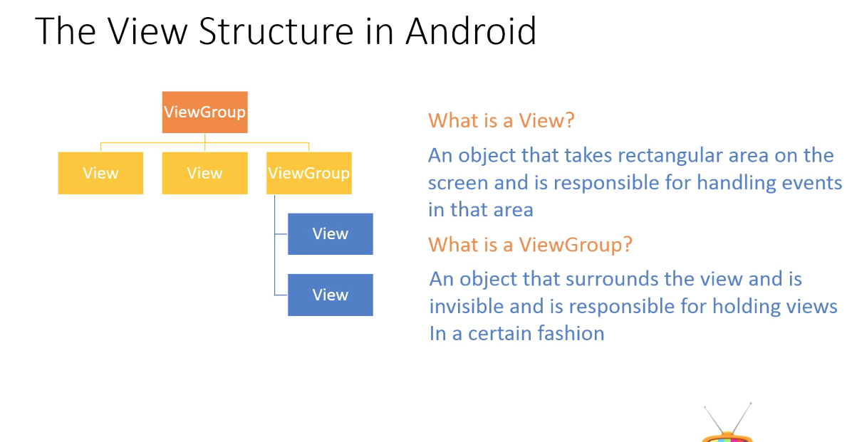
View Structure
May & June 2012 Recruiting Plan
© 2014 Unbounded Solutions
5

Slide 6
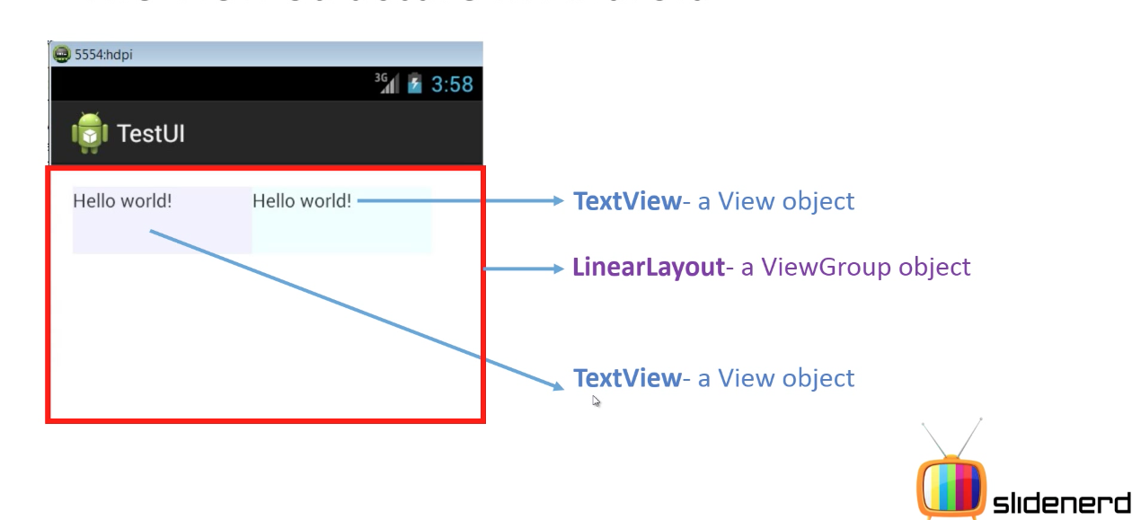
View Structure
May & June 2012 Recruiting Plan
© 2014 Unbounded Solutions
6

Slide 7
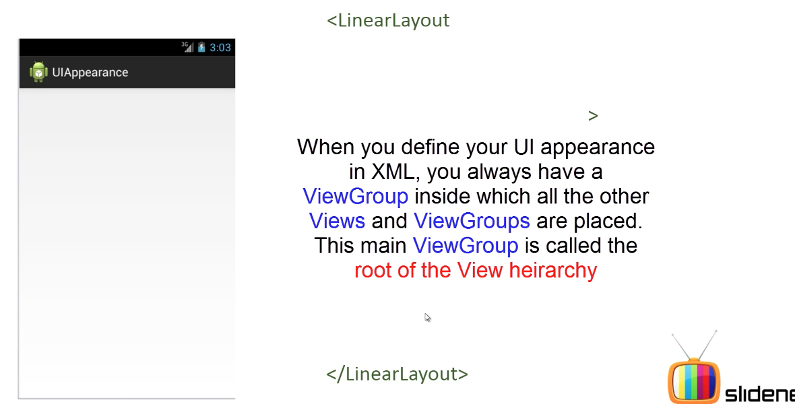
LinearLayout-How to Use it?
May & June 2012 Recruiting Plan
© 2014 Unbounded Solutions
7

Slide 8
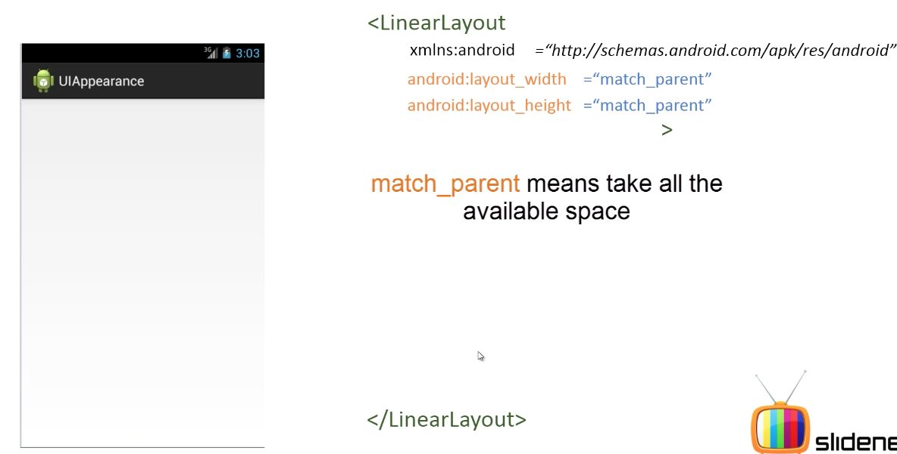
Importatnt Property
May & June 2012 Recruiting Plan
© 2014 Unbounded Solutions
8

Slide 9
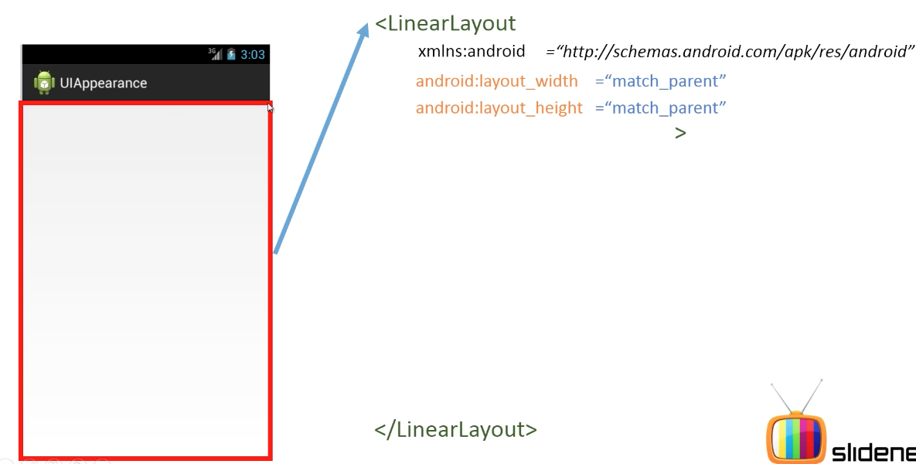
LinearLayout – View Group
May & June 2012 Recruiting Plan
© 2014 Unbounded Solutions
9

Slide 10
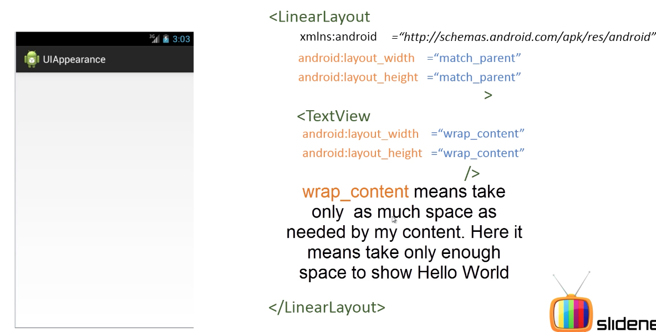
LinearLayout – ViewGroup
May & June 2012 Recruiting Plan
© 2014 Unbounded Solutions
10

Slide 11
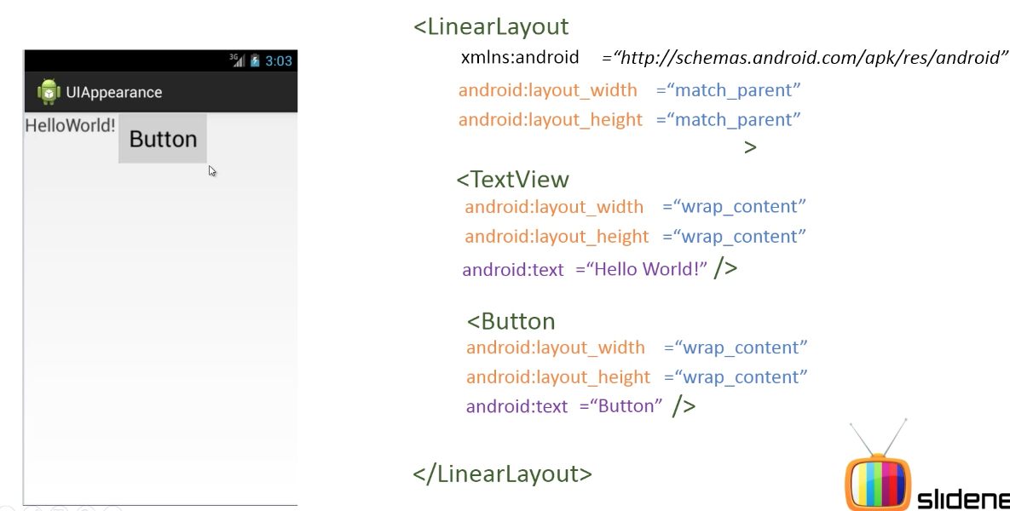
LinearLayout – Horizontal bydefault
May & June 2012 Recruiting Plan
© 2014 Unbounded Solutions
11

Slide 12
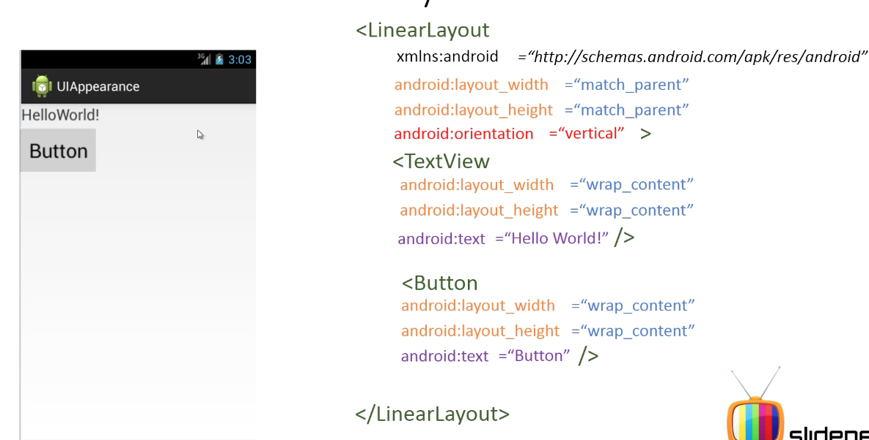
LinearLayout – Vertical
May & June 2012 Recruiting Plan
© 2014 Unbounded Solutions
12

Slide 13
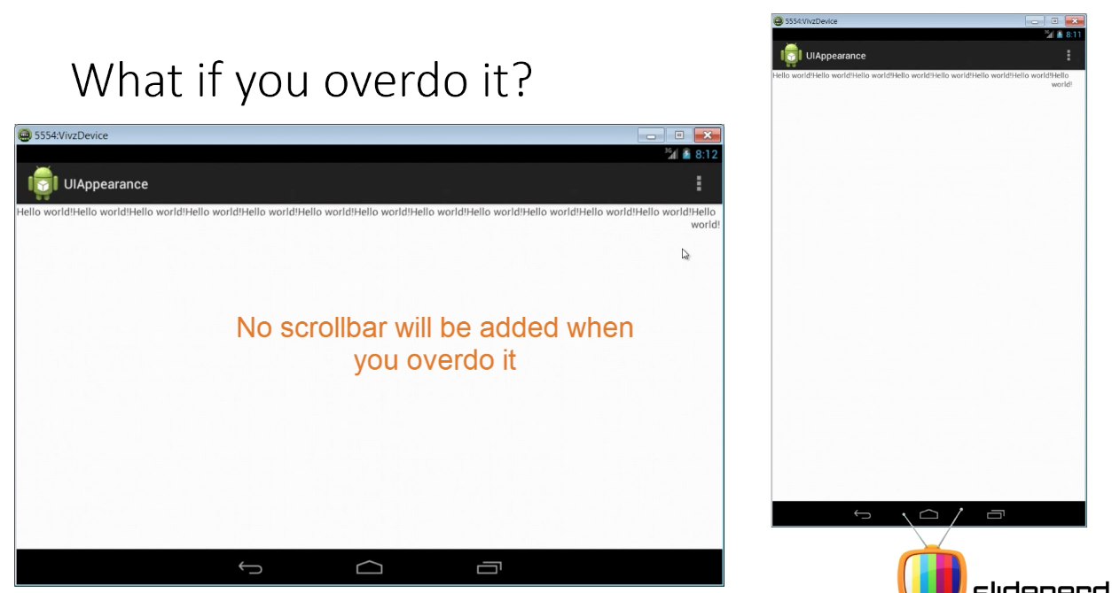
LinearLayout – Drawback
May & June 2012 Recruiting Plan
© 2014 Unbounded Solutions
13

Slide 14
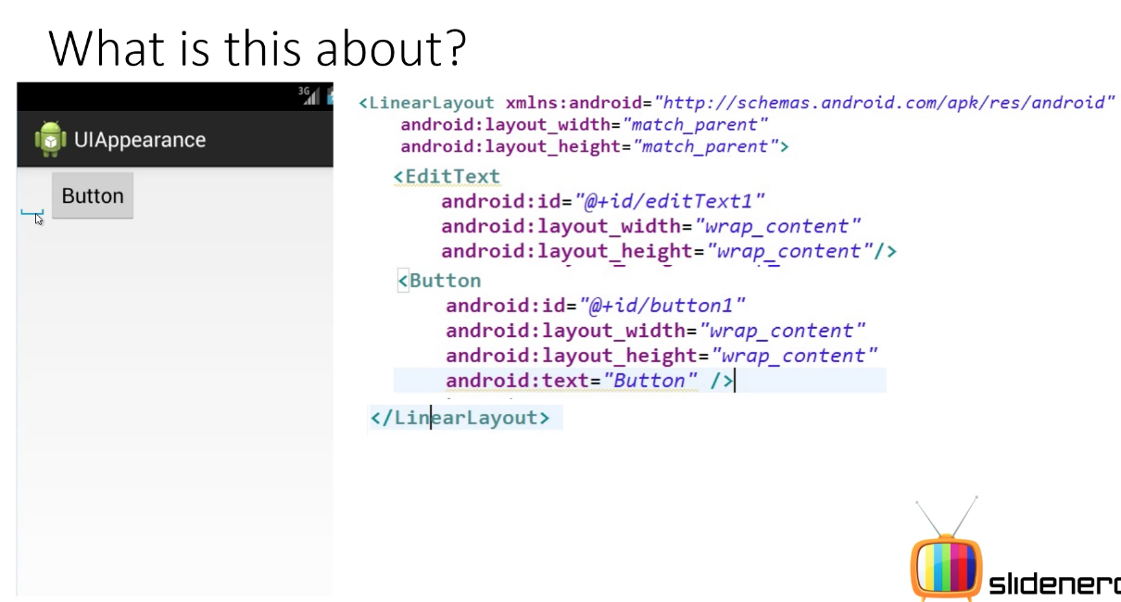
Layout_Weight Property
May & June 2012 Recruiting Plan
© 2014 Unbounded Solutions
14

Slide 15
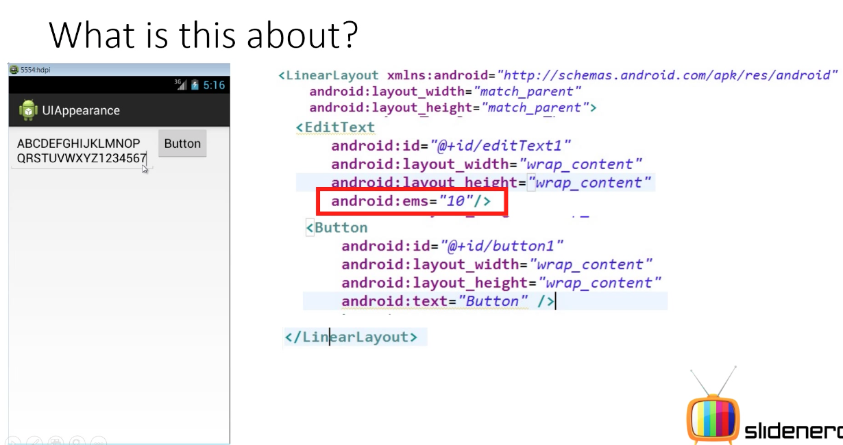
Layout_Weight Property
May & June 2012 Recruiting Plan
© 2014 Unbounded Solutions
15

Slide 16
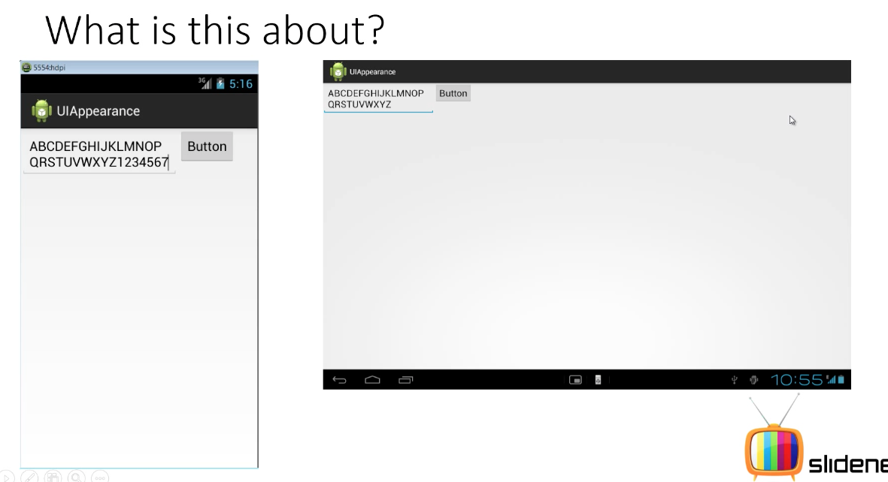
No Consistency in Screens
May & June 2012 Recruiting Plan
© 2014 Unbounded Solutions
16

Slide 17
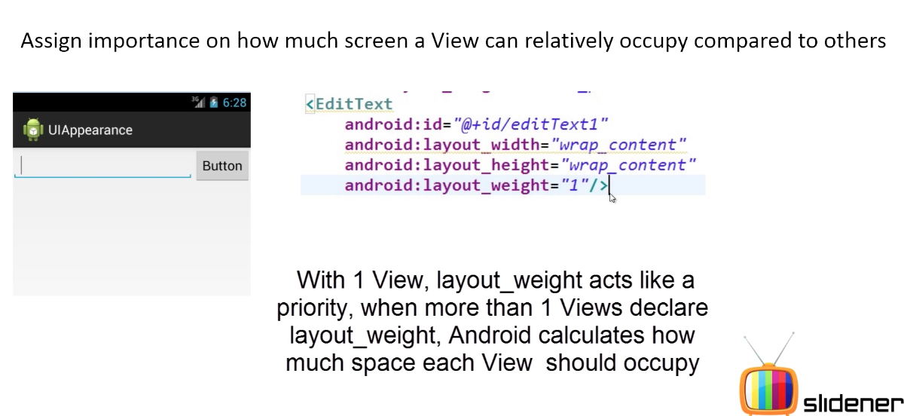
Layout_Weight Property
May & June 2012 Recruiting Plan
© 2014 Unbounded Solutions
17

Slide 18
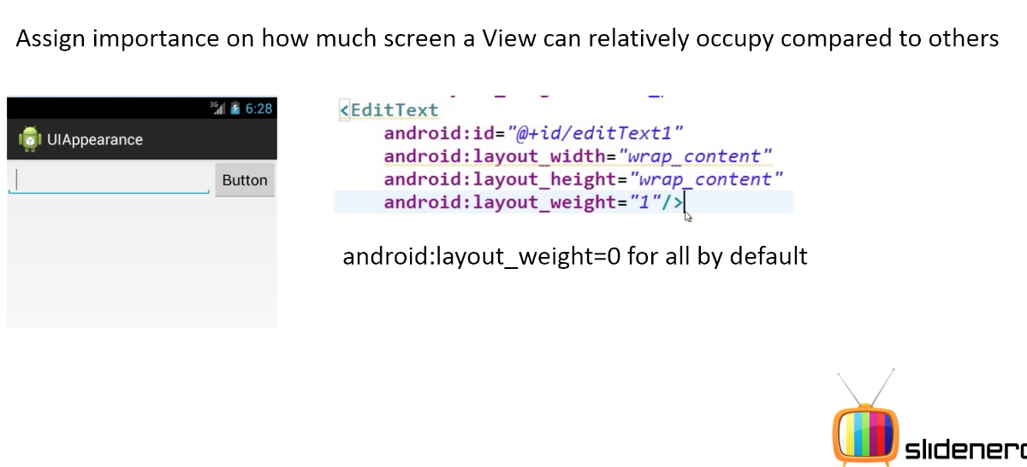
Layout_Weight Property
May & June 2012 Recruiting Plan
© 2014 Unbounded Solutions
18

Slide 19
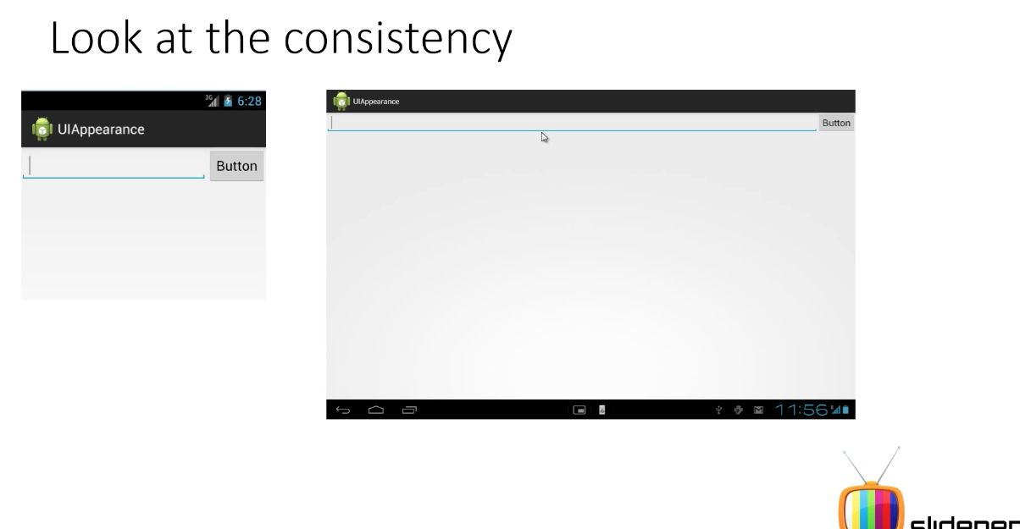
No Consistency in Screens
May & June 2012 Recruiting Plan
© 2014 Unbounded Solutions
19

Slide 20
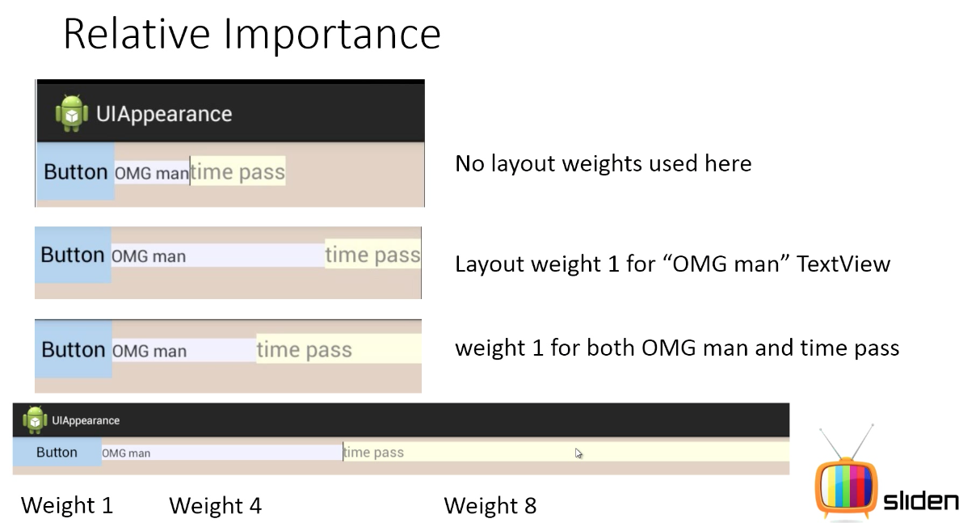
Layout_Weight Importance
May & June 2012 Recruiting Plan
© 2014 Unbounded Solutions
20

Slide 21
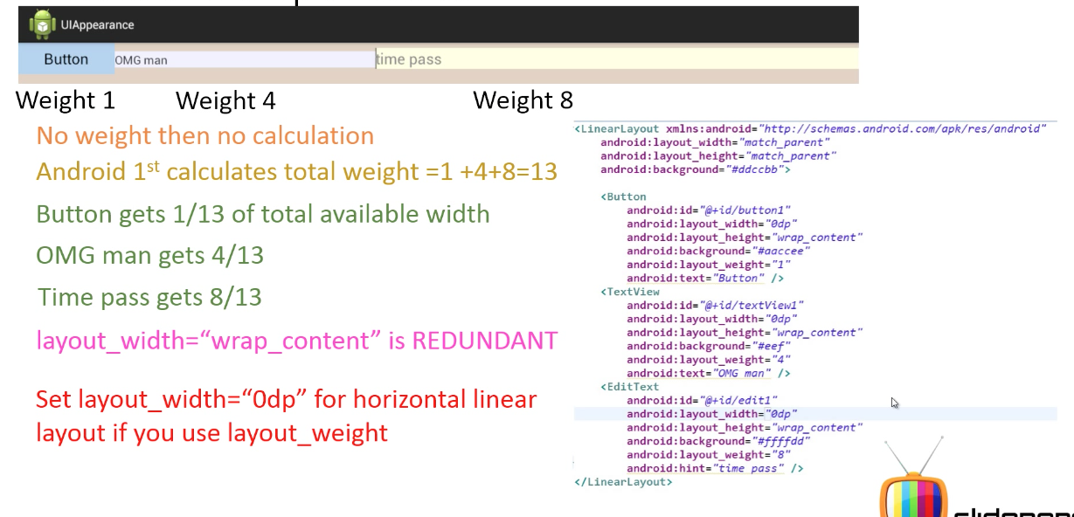
Calculations
May & June 2012 Recruiting Plan
© 2014 Unbounded Solutions
21

Slide 22
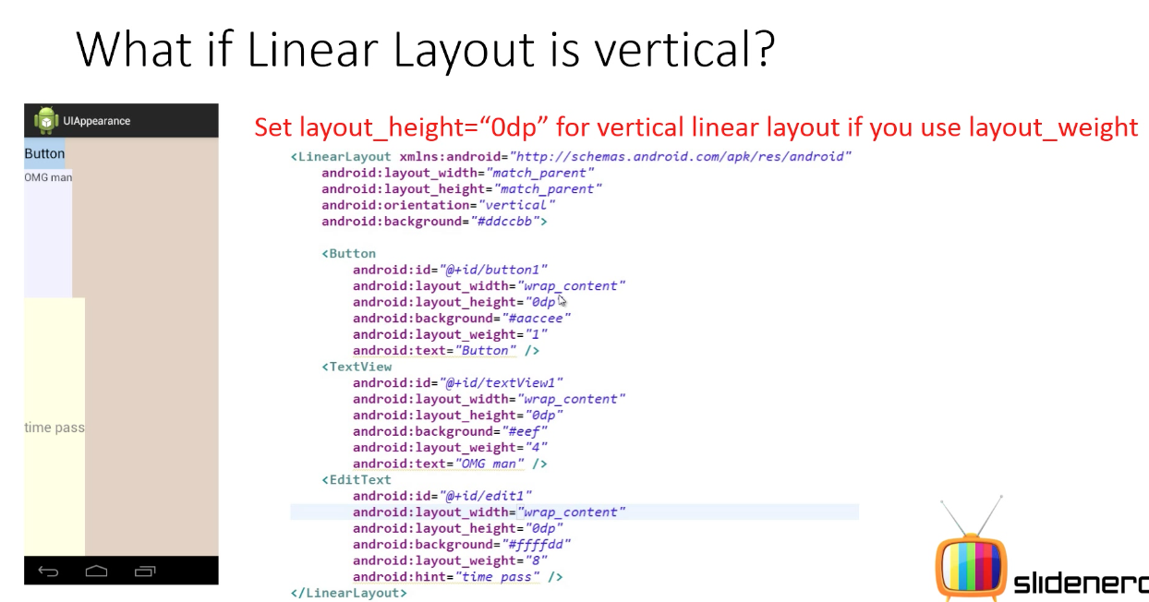
Layout_Weight
May & June 2012 Recruiting Plan
© 2014 Unbounded Solutions
22

Slide 23
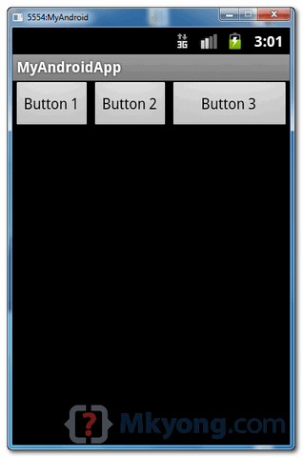
LinearLayout – Horizontal
May & June 2012 Recruiting Plan
<LinearLayout xmlns:android="http://schemas.android.com/apk/res/android"
android:layout_width="fill_parent"
android:layout_height="fill_parent"
android:orientation="horizontal" >
<Button
android:id="@+id/button1"
android:layout_width="wrap_content"
android:layout_height="wrap_content"
android:text="Button 1" />
<Button
android:id="@+id/button2"
android:layout_width="wrap_content"
android:layout_height="wrap_content"
android:text="Button 2" />
<Button
android:id="@+id/button3"
android:layout_width="wrap_content"
android:layout_height="wrap_content"
android:text="Button 3"
android:layout_weight="1"/>
</LinearLayout>
© 2014 Unbounded Solutions
23

Slide 24
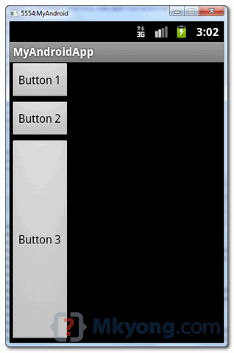
LinearLayout – Vertical
May & June 2012 Recruiting Plan
<LinearLayout xmlns:android="http://schemas.android.com/apk/res/android"
android:layout_width="fill_parent"
android:layout_height="fill_parent"
android:orientation= "vertical" >
<Button
android:id="@+id/button1"
android:layout_width="wrap_content"
android:layout_height="wrap_content"
android:text="Button 1" />
<Button
android:id="@+id/button2"
android:layout_width="wrap_content"
android:layout_height="wrap_content"
android:text="Button 2" />
<Button
android:id="@+id/button3"
android:layout_width="wrap_content"
android:layout_height="wrap_content"
android:text="Button 3"
android:layout_weight="1"/>
</LinearLayout>
© 2014 Unbounded Solutions
24

Slide 25
LinearLayout – Example
May & June 2012 Recruiting Plan
In a linear layout, like the name suggests, all the elements are displayed in a linear fashion(below is an example of the linear layouts), either Horizontally or Vertically and this behavior is set in android:orientation which is an attribute of the node LinearLayout.
Example of Vertical layout snippet
<LinearLayout android:orientation="vertical"> .... </LinearLayout>
Example of Horizontal layout snippet
<LinearLayout android:orientation="horizontal"> .... </LinearLayout>
© 2014 Unbounded Solutions
25

Slide 26
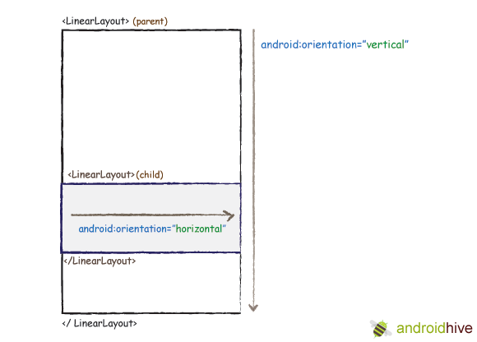
LinearLayout – Example
May & June 2012 Recruiting Plan
© 2014 Unbounded Solutions
26

Slide 27
LinearLayout – Example
May & June 2012 Recruiting Plan
Now that we know the two types of linear layouts, here are the steps you need to follow to create them
Create a new project File -> New -> Android Project
In Package Explorer right click on res/layout folder and create a new Android XML File and name it as you wish. I am naming it as “linear_layout.xml” res/layout -> Right Click -> New -> Android XML File
Now open newly created xml file (in my case “linear_layout.xml”) and type the following code.
© 2014 Unbounded Solutions
27

Slide 28
linear_layout.xml
May & June 2012 Recruiting Plan
<!-- Parent linear layout with vertical orientation -->
<LinearLayout
xmlns:android="http://schemas.android.com/apk/res/android"
android:orientation="vertical"
android:layout_width="match_parent"
android:layout_height="match_parent”>
<TextView
android:layout_width="fill_parent" android:layout_height="wrap_content”
android:text="Email:"
android:padding="5dip"/>
<EditText
android:layout_width="fill_parent" android:layout_height="wrap_content”
android:layout_marginBottom="10dip"/>
<Button
android:layout_width="fill_parent" android:layout_height="wrap_content”
android:text="Login"/>
© 2014 Unbounded Solutions
28

Slide 29
linear_layout.xml
May & June 2012 Recruiting Plan
<!-- Child linear layout with horizontal orientation -->
<LinearLayout
android:layout_width="fill_parent”
android:layout_height="wrap_content”
android:orientation="horizontal"
android:background="#2a2a2a”
android:layout_marginTop="25dip »>
<TextView android:layout_width="fill_parent" android:layout_height="wrap_content”
android:text="Home"
android:padding="15dip"
android:layout_weight="1”
android:gravity="center"/>
<TextView android:layout_width="fill_parent" android:layout_height="wrap_content"
android:text="About"
android:padding="15dip" android:layout_weight="1"
android:gravity="center"/>
</LinearLayout>
</LinearLayout>
© 2014 Unbounded Solutions
29

Slide 30
LinearLayout – Example
May & June 2012 Recruiting Plan
To set this newly created view as the initial view of your app, Open your MainActivity.java file.
You would see the following line inside the onCreate function setContentView(R.layout.main).
Change R.layout.main to R.layout.yourlinearviewname. In my case its R.layout.linear_layout
To run the application, right click on the project -> Run As -> 1. Android Application. You should see your newly created linear layout in the emulator.
© 2014 Unbounded Solutions
30

Slide 31
AndroidLayoutsActivity.java
May & June 2012 Recruiting Plan
package com.example.androidlayouts;
import android.app.Activity;
import android.os.Bundle;
public class AndroidLayoutsActivity extends Activity {
@Override
public void onCreate(Bundle savedInstanceState) {
super.onCreate(savedInstanceState);
setContentView(R.layout.linear_layout);
}
}
© 2014 Unbounded Solutions
31

Slide 32
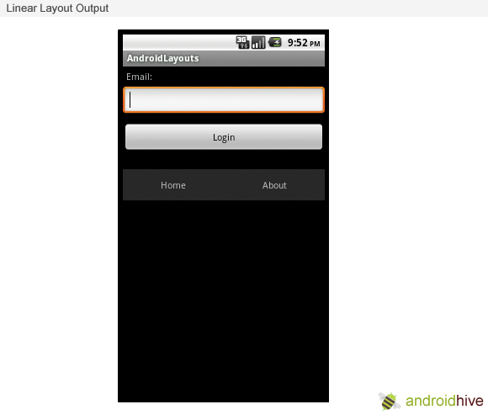
Output
May & June 2012 Recruiting Plan
© 2014 Unbounded Solutions
32

Slide 33
Topic #7.1
May & June 2012 Recruiting Plan
Recruit 70 “Best Fit” Consulting Employees
Build out a Marketing team dedicated to recruiting
Formalize training program for new recruiters
Build out fully functioning offshore recruiting team
Implement call quality feedback loops
Coach and Mentor recruiters
Improve daily efficiency for recruiting team
Relative Layouts
© 2014 Unbounded Solutions
33

Slide 34
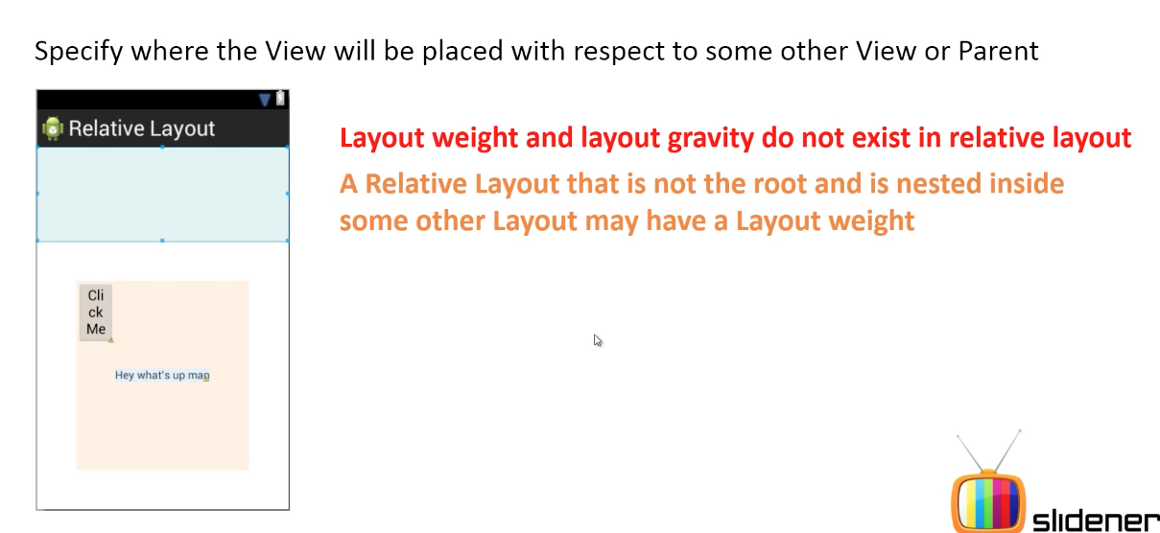
What is Relative Layout?
May & June 2012 Recruiting Plan
© 2014 Unbounded Solutions
34

Slide 35
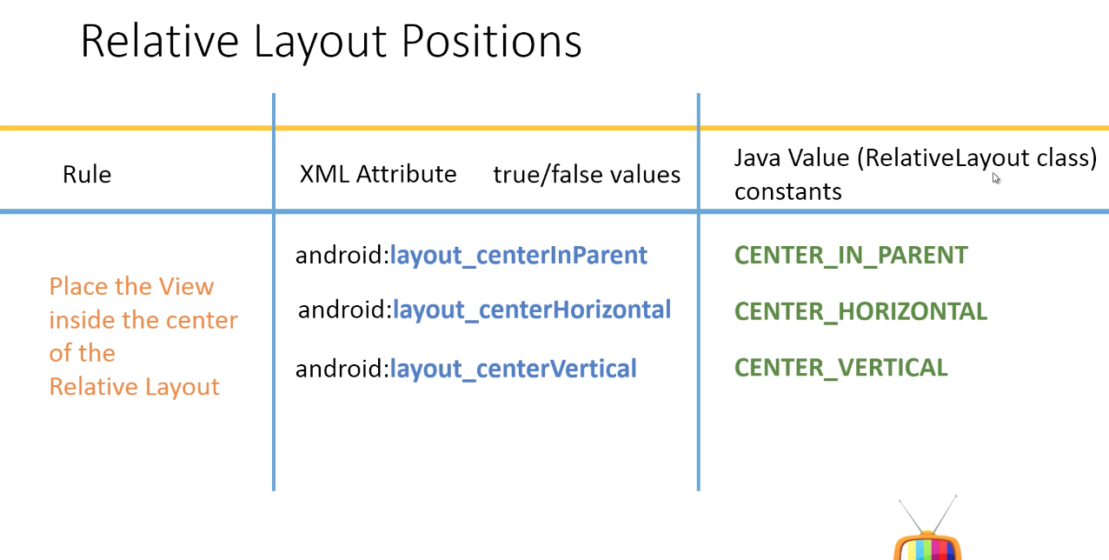
Relative Layout
May & June 2012 Recruiting Plan
© 2014 Unbounded Solutions
35

Slide 36
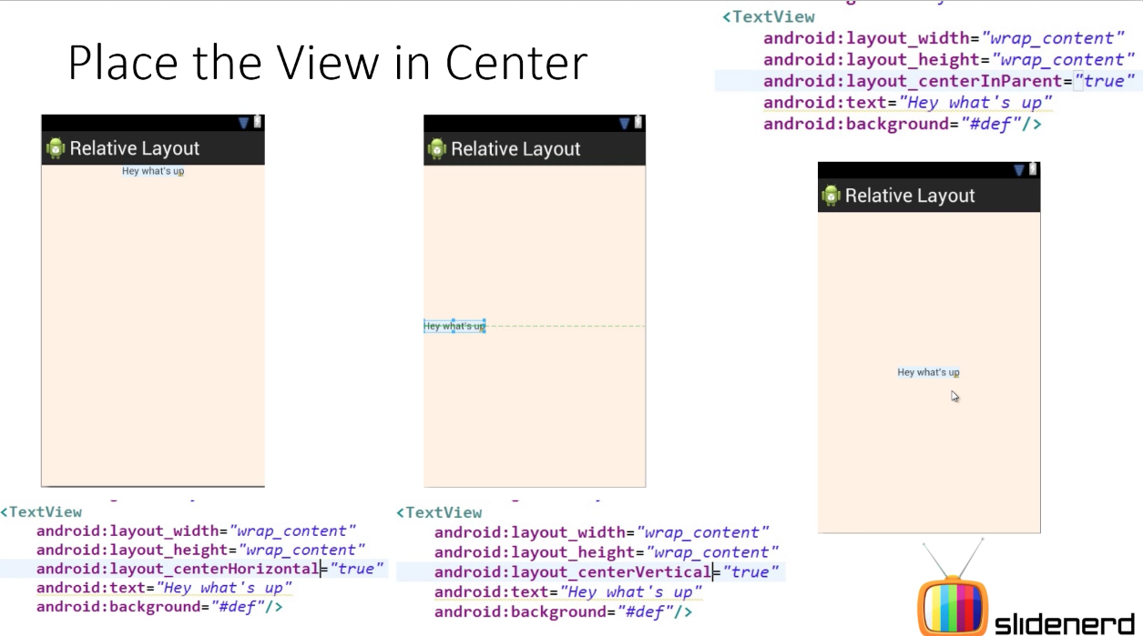
Relative Layout
May & June 2012 Recruiting Plan
© 2014 Unbounded Solutions
36

Slide 37
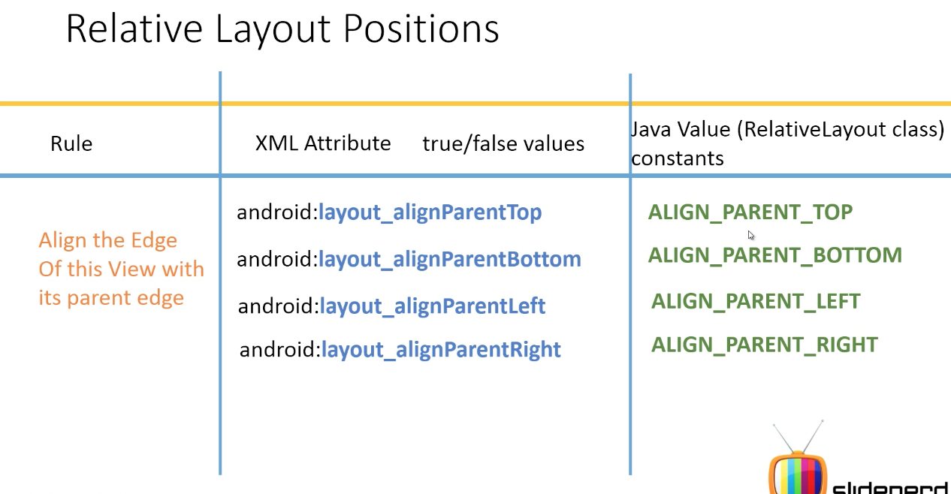
Relative Layout
May & June 2012 Recruiting Plan
© 2014 Unbounded Solutions
37

Slide 38
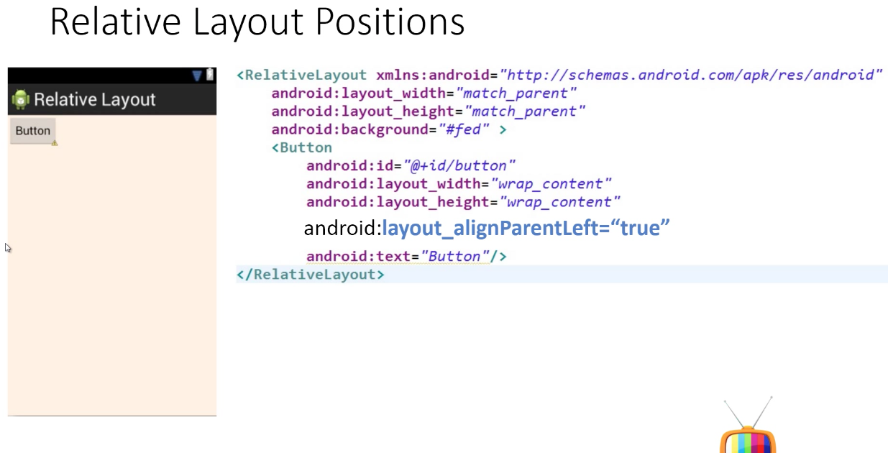
Relative Layout
May & June 2012 Recruiting Plan
© 2014 Unbounded Solutions
38

Slide 39
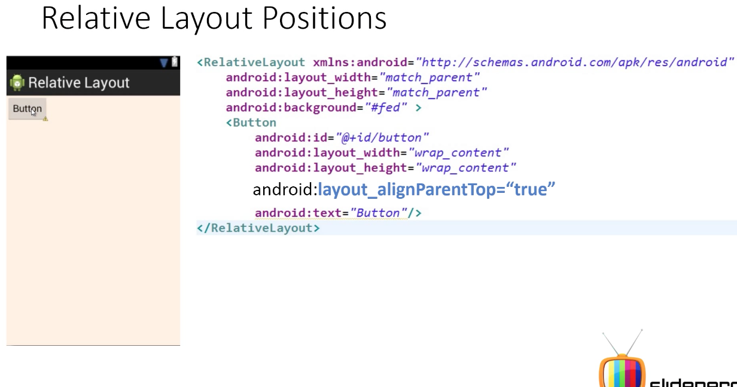
Relative Layout
May & June 2012 Recruiting Plan
© 2014 Unbounded Solutions
39

Slide 40
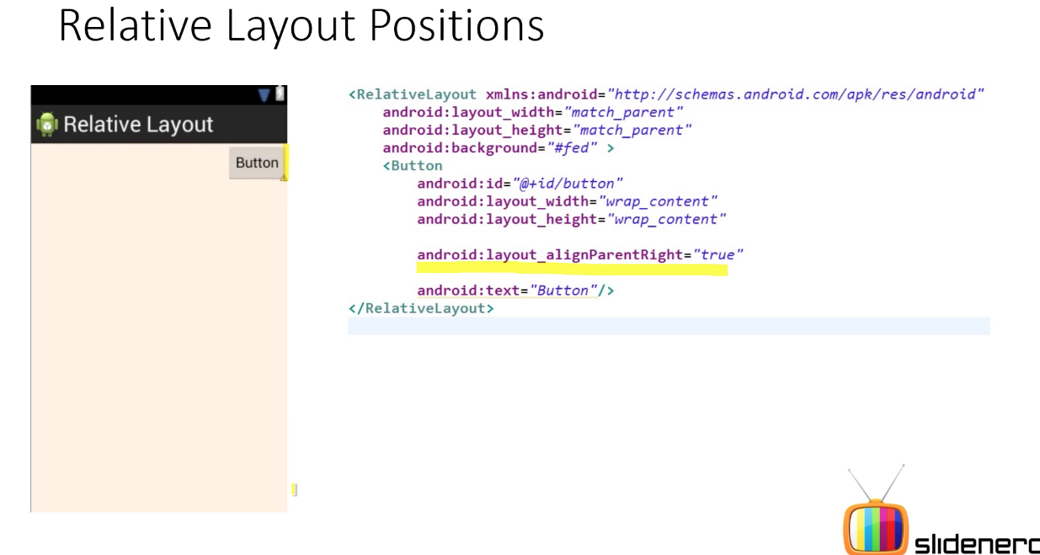
Relative Layout
May & June 2012 Recruiting Plan
© 2014 Unbounded Solutions
40

Slide 41
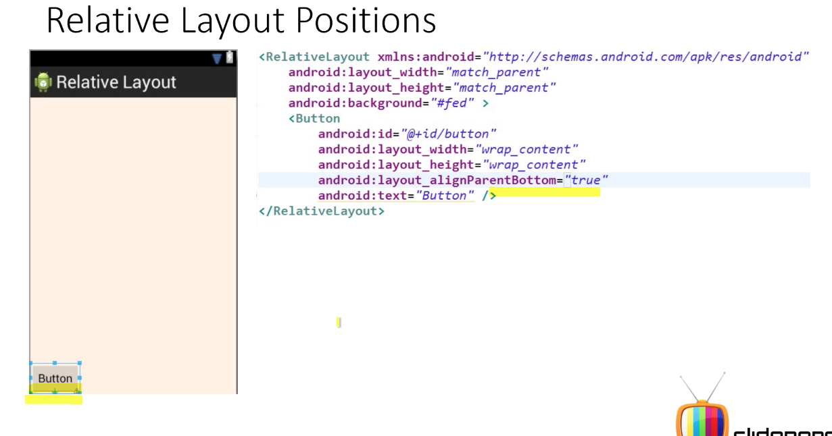
Relative Layout
May & June 2012 Recruiting Plan
© 2014 Unbounded Solutions
41

Slide 42
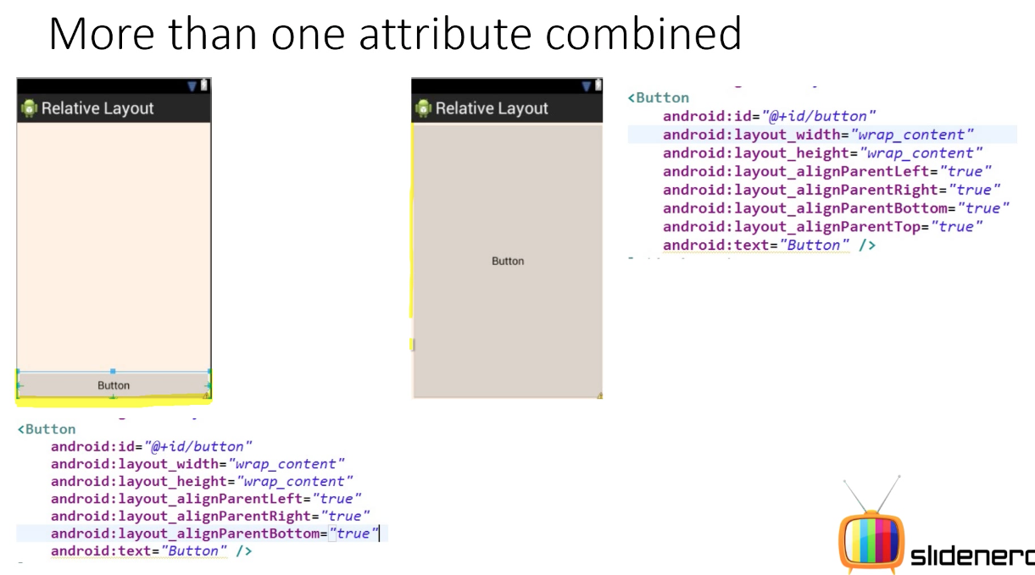
Relative Layout
May & June 2012 Recruiting Plan
© 2014 Unbounded Solutions
42

Slide 43
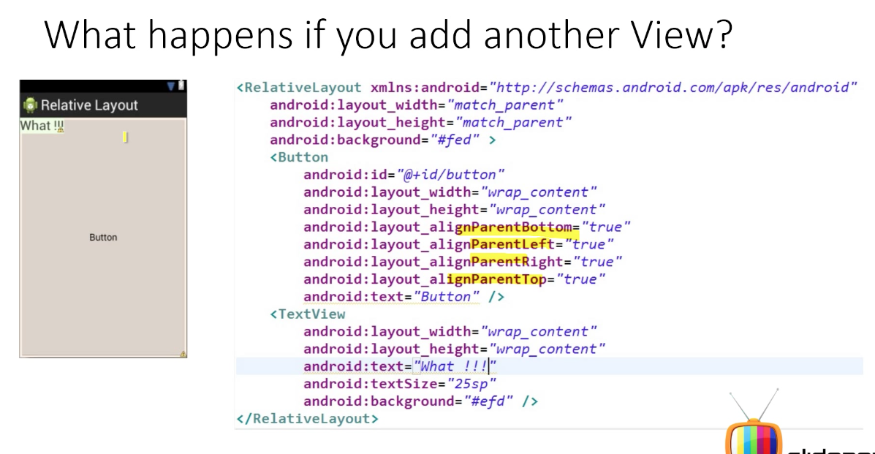
Relative Layout
May & June 2012 Recruiting Plan
© 2014 Unbounded Solutions
43

Slide 44
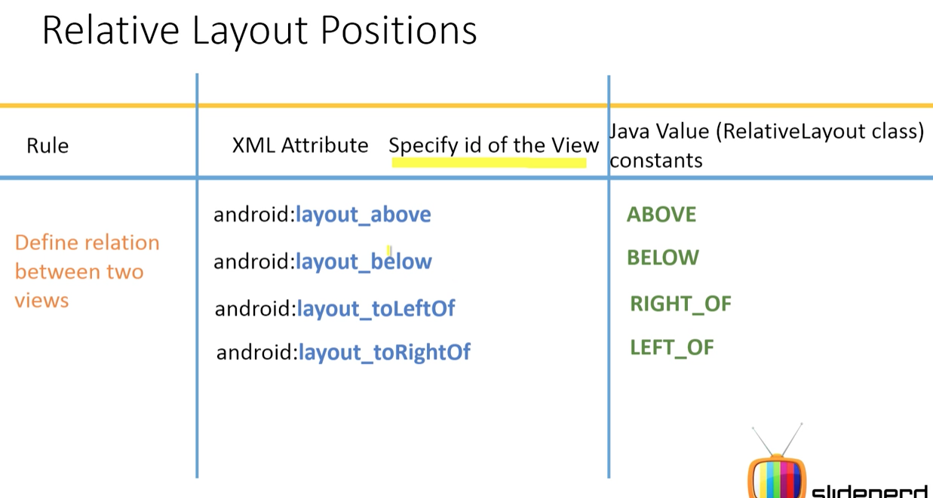
Relative Layout
May & June 2012 Recruiting Plan
© 2014 Unbounded Solutions
44

Slide 45
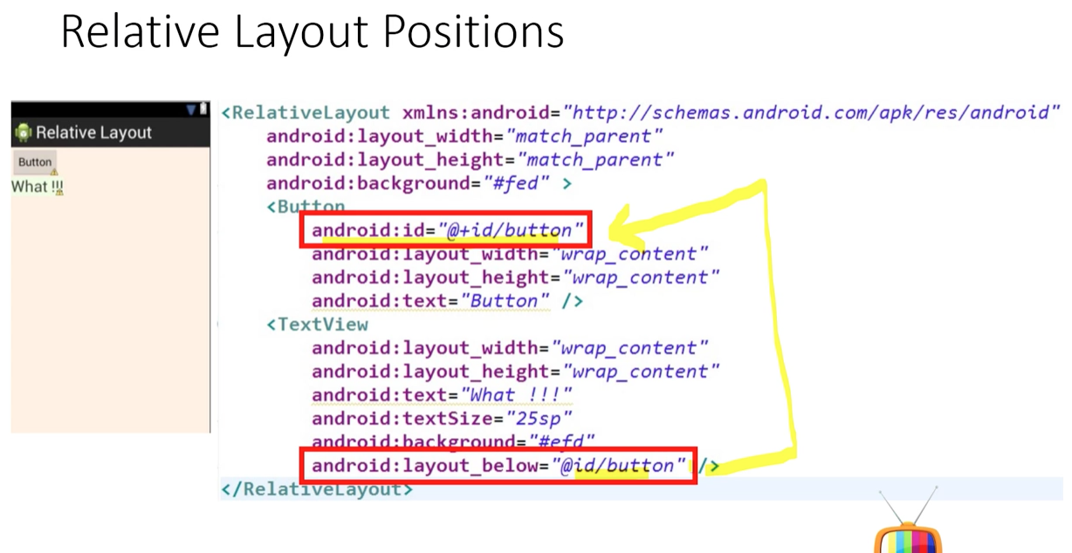
RelativeLayout– Example
May & June 2012 Recruiting Plan
© 2014 Unbounded Solutions
45

Slide 46
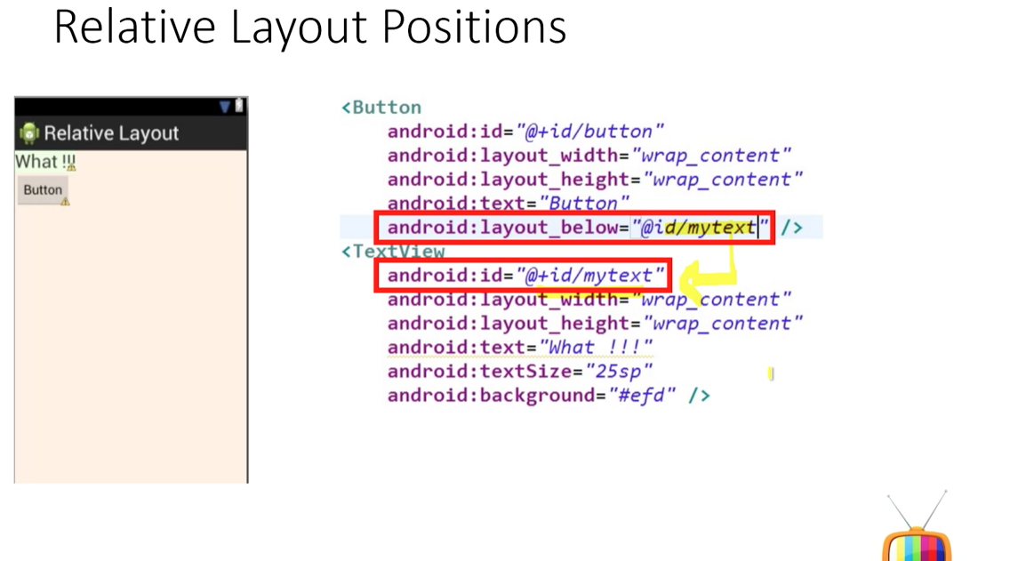
RelativeLayout– Example
May & June 2012 Recruiting Plan
© 2014 Unbounded Solutions
46

Slide 47
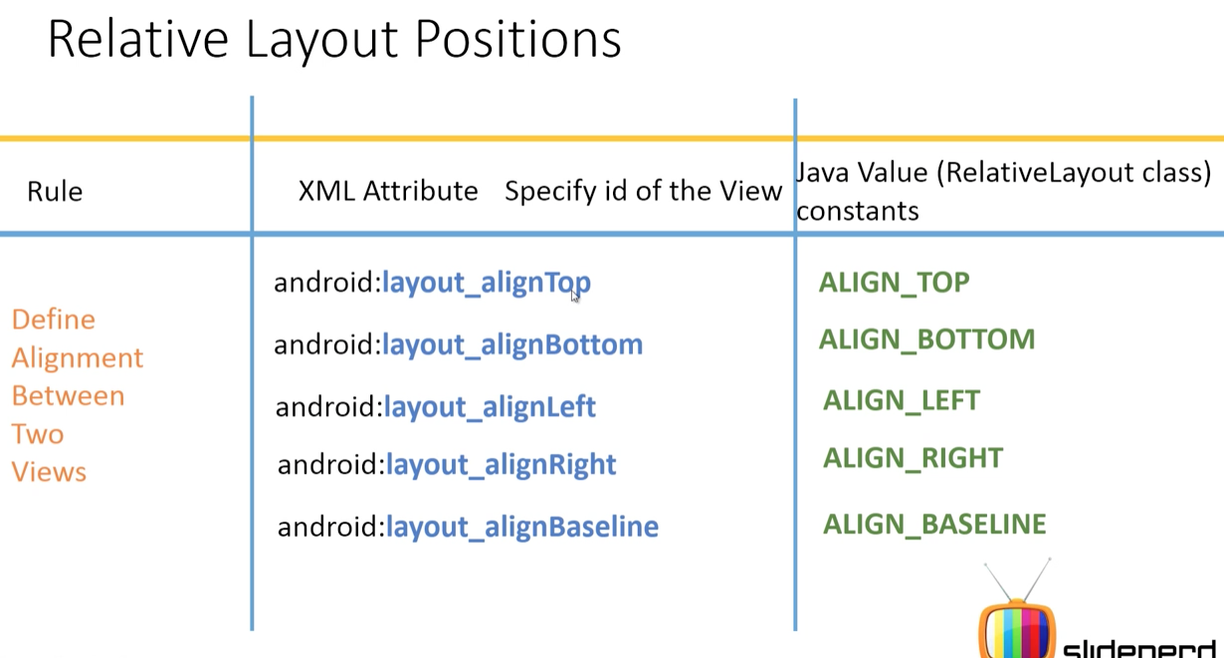
RelativeLayout– Example
May & June 2012 Recruiting Plan
© 2014 Unbounded Solutions
47

Slide 48
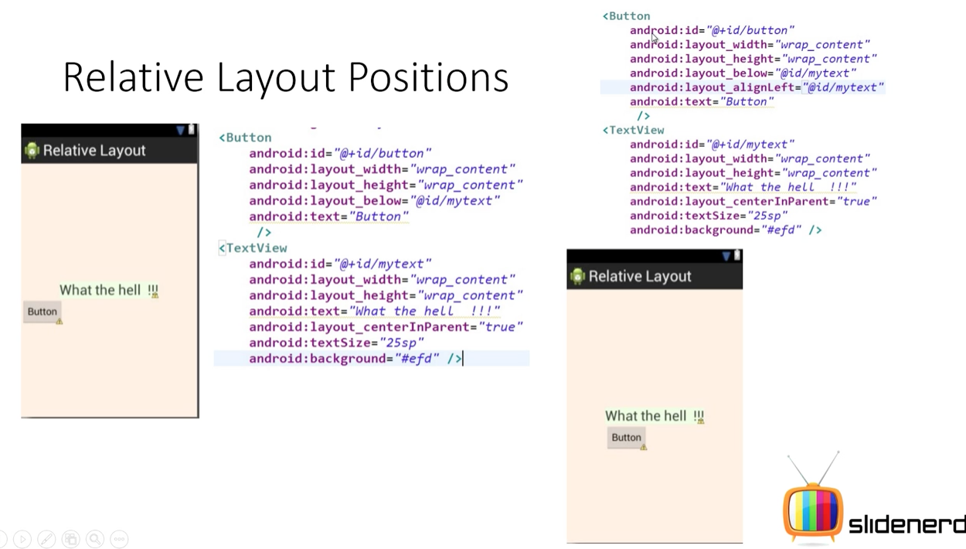
RelativeLayout– Example
May & June 2012 Recruiting Plan
© 2014 Unbounded Solutions
48

Slide 49
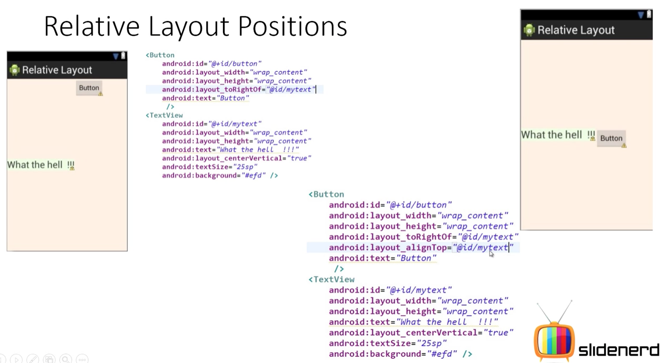
RelativeLayout– Example
May & June 2012 Recruiting Plan
© 2014 Unbounded Solutions
49

Slide 50
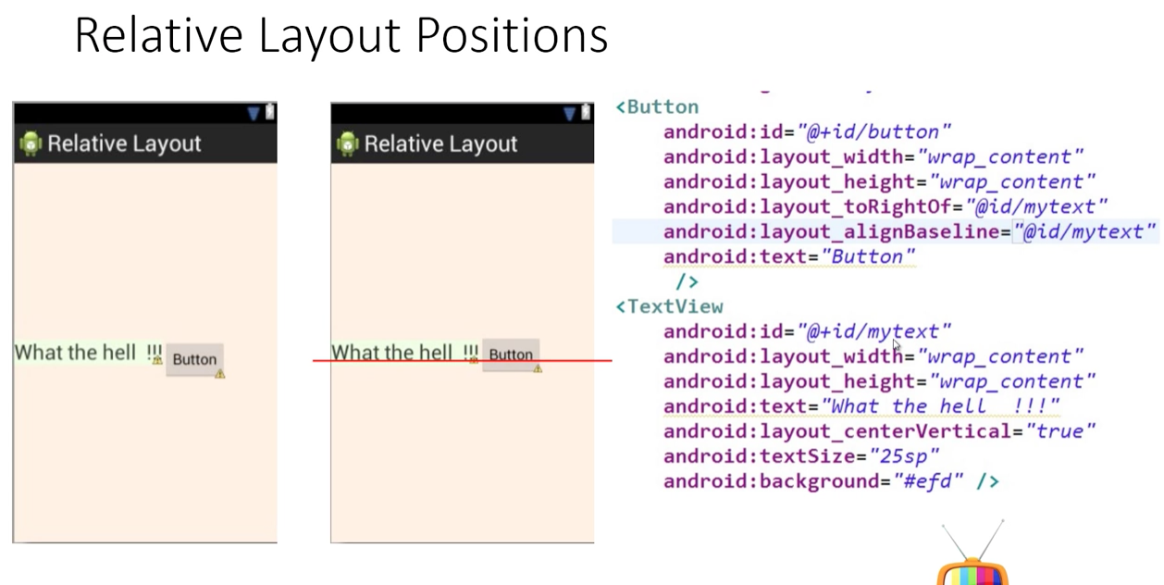
RelativeLayout– Example
May & June 2012 Recruiting Plan
© 2014 Unbounded Solutions
50

Slide 51
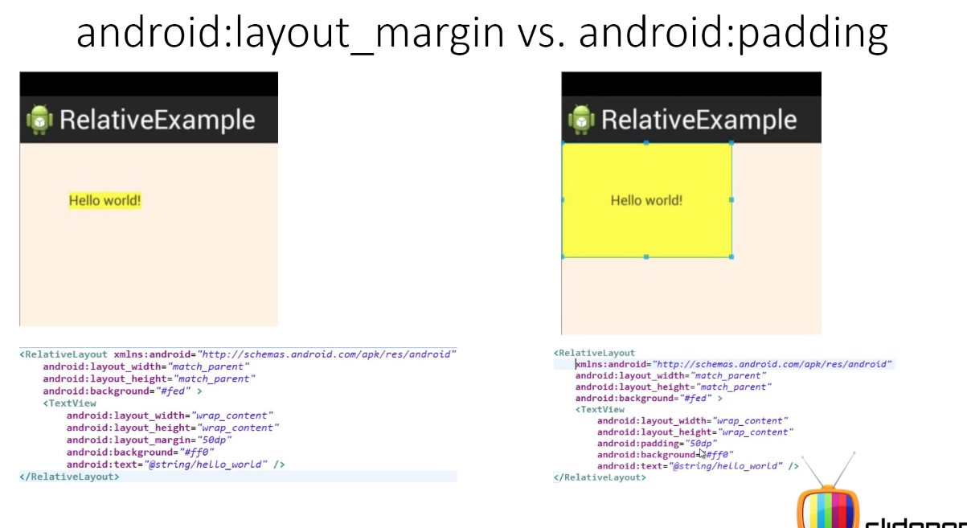
Layouts
May & June 2012 Recruiting Plan
© 2014 Unbounded Solutions
51

Slide 52
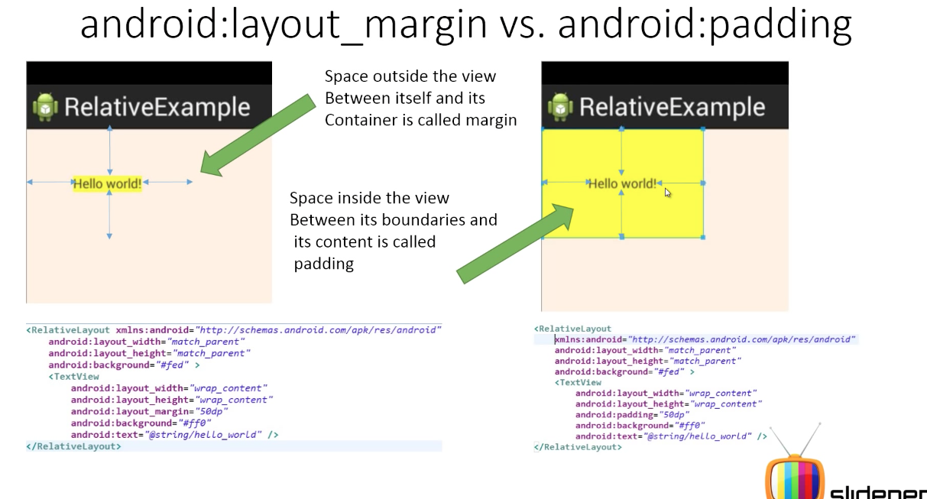
Layouts
May & June 2012 Recruiting Plan
© 2014 Unbounded Solutions
52

Slide 53
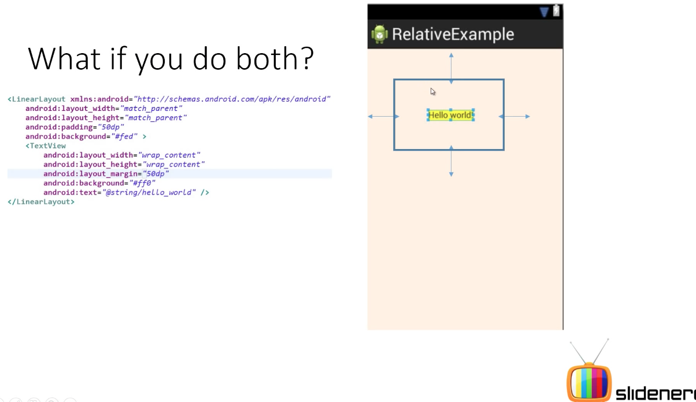
Margin v/s Padding
May & June 2012 Recruiting Plan
Padding set=50
© 2014 Unbounded Solutions
53

Slide 54
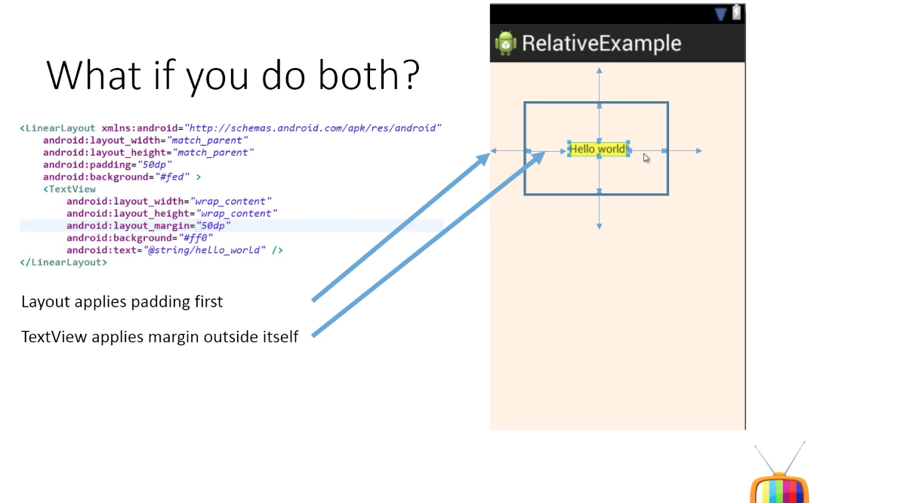
Margin v/s Padding
May & June 2012 Recruiting Plan
© 2014 Unbounded Solutions
54

Slide 55
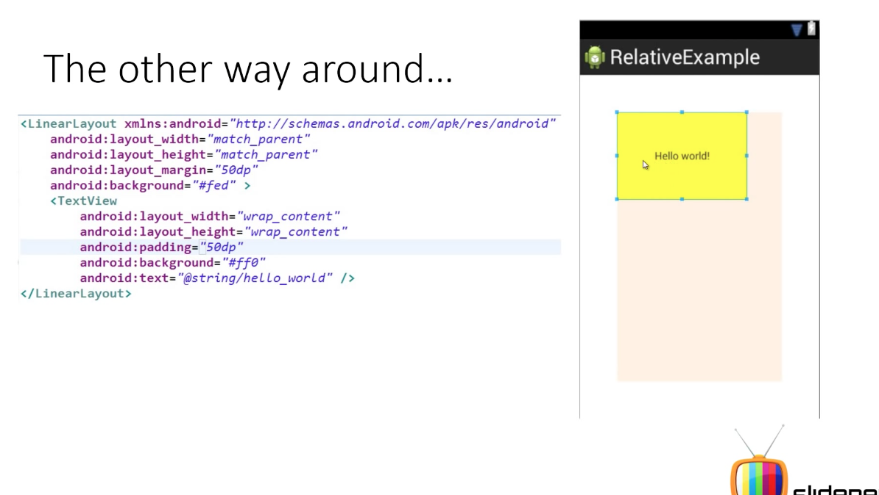
Margin v/s Padding
May & June 2012 Recruiting Plan
Margin set=50
© 2014 Unbounded Solutions
55

Slide 56
RelativeLayout – Example
May & June 2012 Recruiting Plan
In a relative layout every element arranges itself relative to other elements or a parent element. As an example, lets consider the layout defined below.
The “Cancel” button is placed relatively, to the right of the “Login” button parallelly.
Here is the code snippet that achieves the mentioned alignment (Right of Login button parallel)
Example code snippet
<Button android:id="@+id/btnLogin" ..></Button>
<Button android:layout_toRightOf="@id/btnLogin"
android:layout_alignTop="@id/btnLogin" ..></Button>
© 2014 Unbounded Solutions
56

Slide 57
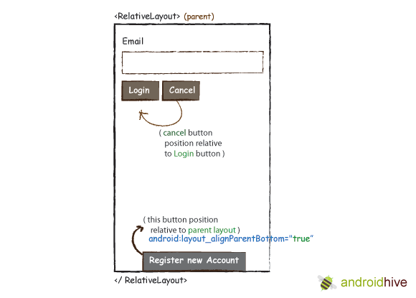
RelativeLayout– Example
May & June 2012 Recruiting Plan
© 2014 Unbounded Solutions
57

Slide 58
RelativeLayout – Example
May & June 2012 Recruiting Plan
Here are the steps to create a relative layout
Create a new project File -> New -> Android Project In Package Explorer right click on res/layout folder and create a new Android XML File and name it as you wish.
I am naming it as “relative_layout.xml” res/layout -> Right Click -> New -> Android XML File
Now open newly created xml file (in my case “relative_layout.xml”) and type the following code.
© 2014 Unbounded Solutions
58

Slide 59
relative_layout.xml
May & June 2012 Recruiting Plan
<<RelativeLayout xmlns:android="http://schemas.android.com/apk/res/android"
android:layout_width="fill_parent"
android:layout_height="wrap_content”>
<TextView android:id="@+id/label" android:layout_width="fill_parent”
android:layout_height="wrap_content"
android:text="Email" />
<EditText android:id="@+id/inputEmail" android:layout_width="fill_parent”
android:layout_height="wrap_content"
android:layout_below="@id/label" />
© 2014 Unbounded Solutions
59

Slide 60
relative_layout.xml
May & June 2012 Recruiting Plan
< <Button android:layout_width="wrap_content" android:layout_height="wrap_content"
android:layout_toRightOf="@id/btnLogin"
android:layout_alignTop="@id/btnLogin" android:text="Cancel" />
<Button android:layout_width="wrap_content" android:layout_height="wrap_content"
android:layout_alignParentBottom="true" android:text="Register new Account"
android:layout_centerHorizontal="true"/>
</RelativeLayout>
© 2014 Unbounded Solutions
60

Slide 61
RelativeLayout – Example
May & June 2012 Recruiting Plan
Same like before open your MainActivity.java file and set the layout to your newly created relative layout file. In my case its R.layout.relative_layout
setContentView(R.layout.relative_layout);
To run the application, right click on the project -> Run As -> 1. Android Application. You should see your newly created relative layout in the emulator.
© 2014 Unbounded Solutions
61

Slide 62
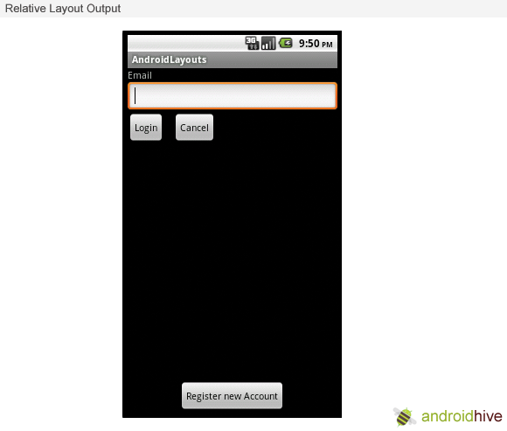
Output
May & June 2012 Recruiting Plan
© 2014 Unbounded Solutions
62

Slide 63
Topic #7.2
May & June 2012 Recruiting Plan
Recruit 70 “Best Fit” Consulting Employees
Build out a Marketing team dedicated to recruiting
Formalize training program for new recruiters
Build out fully functioning offshore recruiting team
Implement call quality feedback loops
Coach and Mentor recruiters
Improve daily efficiency for recruiting team
Table Layout
© 2014 Unbounded Solutions
63

Slide 64
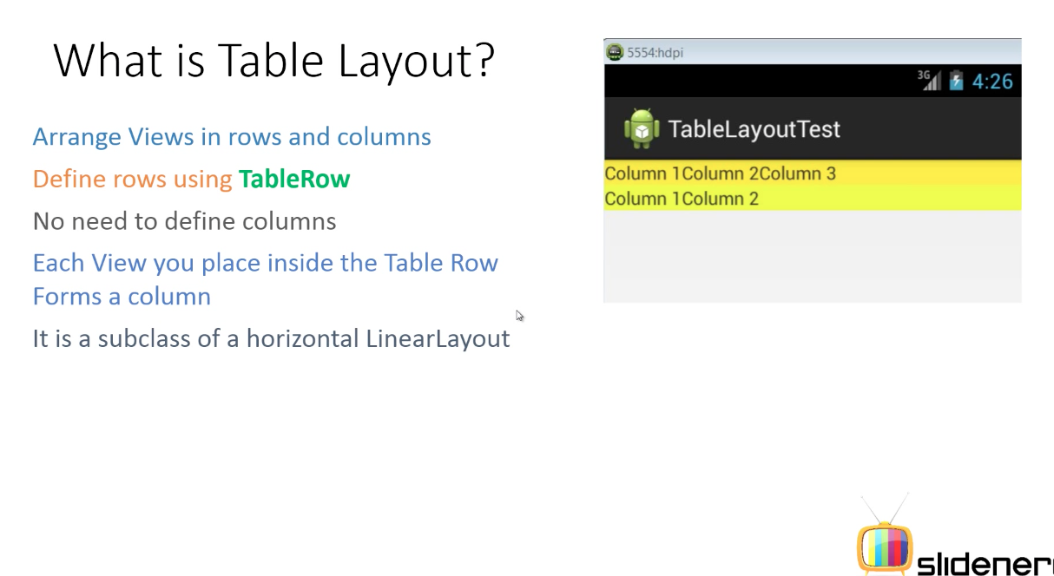
Table Layout
May & June 2012 Recruiting Plan
© 2014 Unbounded Solutions
64

Slide 65
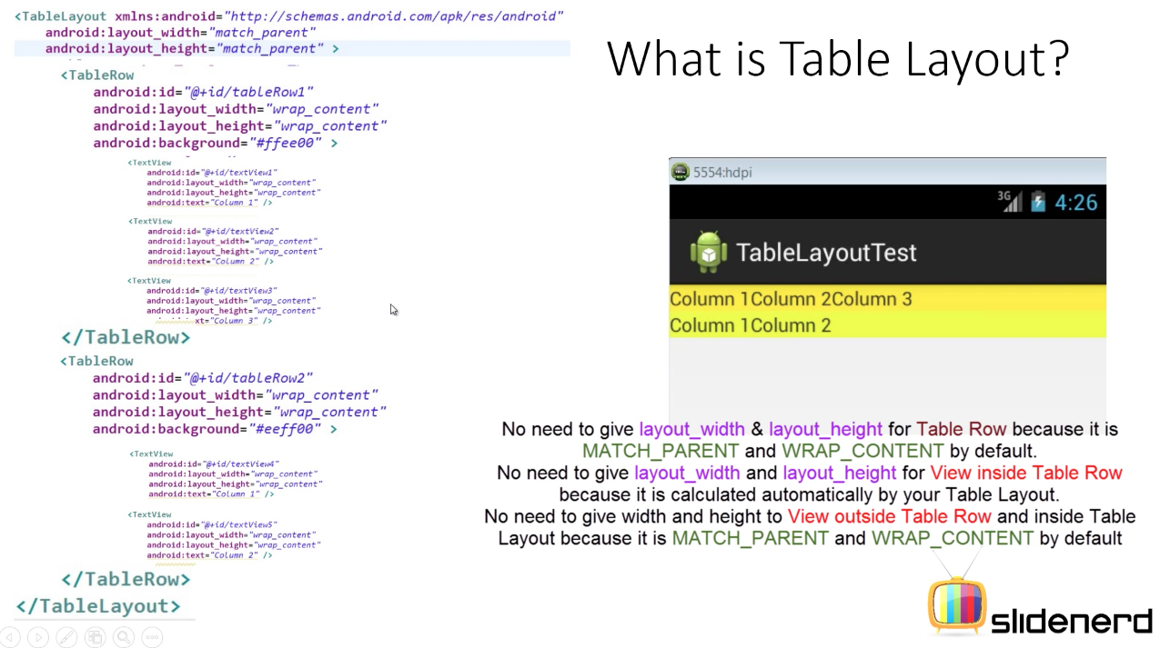
Table Layout
May & June 2012 Recruiting Plan
© 2014 Unbounded Solutions
65

Slide 66
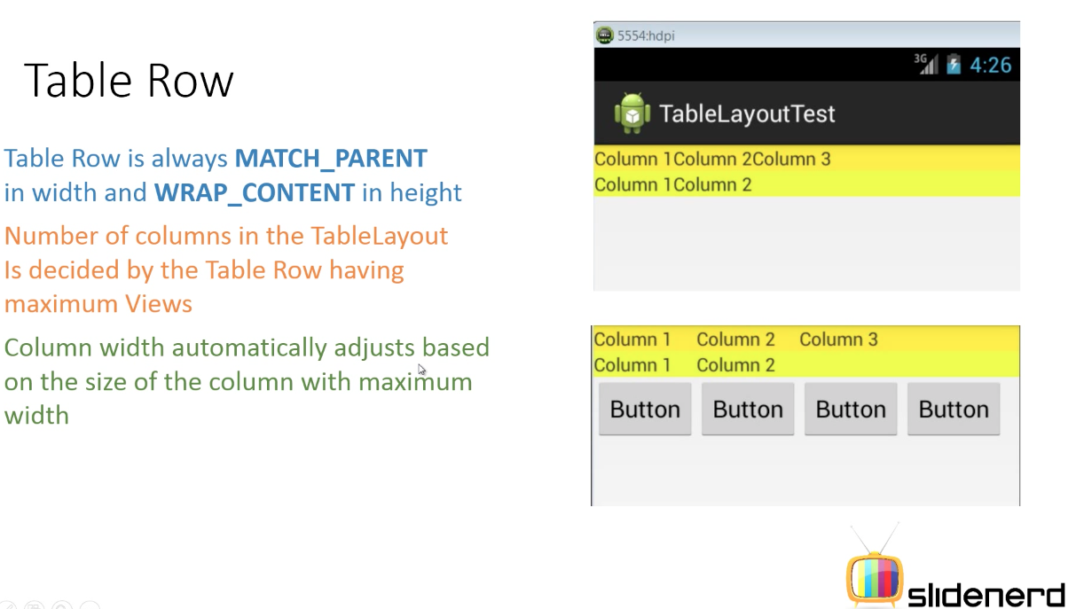
Table Layout
May & June 2012 Recruiting Plan
© 2014 Unbounded Solutions
66

Slide 67
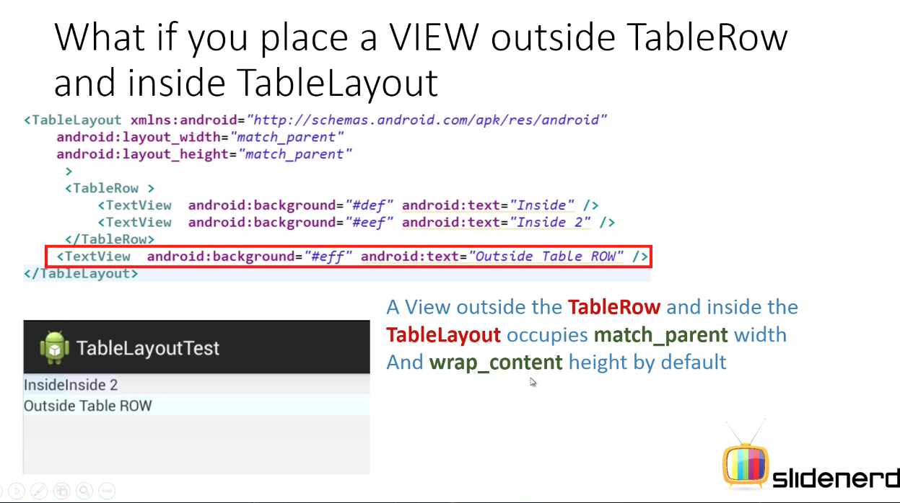
Table Layout
May & June 2012 Recruiting Plan
© 2014 Unbounded Solutions
67

Slide 68

Table Layout
May & June 2012 Recruiting Plan
© 2014 Unbounded Solutions
68

Slide 69

Table Layout
May & June 2012 Recruiting Plan
© 2014 Unbounded Solutions
69

Slide 70

Table Layout
© 2014 Unbounded Solutions
70

Slide 71

Table Layout
May & June 2012 Recruiting Plan
No span used
© 2014 Unbounded Solutions
71

Slide 72

Table Layout
May & June 2012 Recruiting Plan
© 2014 Unbounded Solutions
72

Slide 73

Table Layout
May & June 2012 Recruiting Plan
Want to shift to column no 3
© 2014 Unbounded Solutions
73

Slide 74

Table Layout
May & June 2012 Recruiting Plan
Now its shifted
© 2014 Unbounded Solutions
74

Slide 75

Table Layout
May & June 2012 Recruiting Plan
© 2014 Unbounded Solutions
75

Slide 76

Example
May & June 2012 Recruiting Plan
© 2014 Unbounded Solutions
76

Slide 77

Example
May & June 2012 Recruiting Plan
No column1 Visible
© 2014 Unbounded Solutions
77

Slide 78

Table Layout
May & June 2012 Recruiting Plan
None columns are visible
© 2014 Unbounded Solutions
78

Slide 79
TableLayout – Example
May & June 2012 Recruiting Plan
Create a new project File -> New -> Android Project
In Package Explorer right click on res/layout folder and create a new Android XML File and name it as you wish.
I am naming it as “table_layout.xml” res/layout -> Right Click -> New -> Android XML File
Now open newly created xml file (in my case “table_layout.xml”) and type the following code.
© 2014 Unbounded Solutions
79

Slide 80
table_layout.xml
May & June 2012 Recruiting Plan
<<TableLayout
xmlns:android="http://schemas.android.com/apk/res/android"
android:layout_width="match_parent"
android:layout_height="match_parent"
android:shrinkColumns="*" android:stretchColumns="*" android:background="#ffffff">
<!-- Row 1 with single column -->
<TableRow
android:layout_height="wrap_content"
android:layout_width="fill_parent"
android:gravity="center_horizontal">
<TextView
android:layout_width="match_parent" android:layout_height="wrap_content"
android:textSize="18dp" android:text="Row 1" android:layout_span="3"
android:padding="18dip" android:background="#b0b0b0"
android:textColor="#000"/>
</TableRow>
© 2014 Unbounded Solutions
80

Slide 81
table_layout.xml
May & June 2012 Recruiting Plan
<!-- Row 2 with 3 columns -->
<TableRow
android:id="@+id/tableRow1"
android:layout_height="wrap_content"
android:layout_width="match_parent">
<TextView android:id="@+id/TextView04"
android:text="Row 2 column 1"
android:layout_weight="1"
android:background="#dcdcdc"
android:textColor="#000000"
android:padding="20dip" android:gravity="center"/>
<TextView android:id="@+id/TextView04"
android:text="Row 2 column 2"
android:layout_weight="1" android:background="#d3d3d3"
android:textColor="#000000"
android:padding="20dip" android:gravity="center"/>
© 2014 Unbounded Solutions
81

Slide 82
table_layout.xml
May & June 2012 Recruiting Plan
<TextView
android:id="@+id/TextView04" android:text="Row 2 column 3"
android:layout_weight="1" android:background="#cac9c9"
android:textColor="#000000"
android:padding="20dip" android:gravity="center"/>
</TableRow>
<!-- Row 3 with 2 columns -->
<TableRow
android:layout_height="wrap_content"
android:layout_width="fill_parent"
android:gravity="center_horizontal">
© 2014 Unbounded Solutions
82

Slide 83
table_layout.xml
May & June 2012 Recruiting Plan
<TextView
android:id="@+id/TextView04" android:text="Row 3 column 1"
android:layout_weight="1" android:background="#b0b0b0"
android:textColor="#000000"
android:padding="20dip" android:gravity="center"/>
<TextView
android:id="@+id/TextView04" android:text="Row 3 column 2"
android:layout_weight="1" android:background="#a09f9f"
android:textColor="#000000"
android:padding="20dip" android:gravity="center"/>
</TableRow>
</TableLayout>
© 2014 Unbounded Solutions
83

Slide 84
Table Layout – Example
May & June 2012 Recruiting Plan
Same like before open your MainActivity.java file and set the layout to your newly created table layout file. In my case its R.layout.table_layout
setContentView(R.layout.table_layout);
To run the application, right click on the project -> Run As -> 1. Android Application. You should see your newly created table layout in the emulator.
© 2014 Unbounded Solutions
84

Slide 85


Output
May & June 2012 Recruiting Plan
© 2014 Unbounded Solutions
85

Slide 86
Topic #7.3
May & June 2012 Recruiting Plan
Recruit 70 “Best Fit” Consulting Employees
Build out a Marketing team dedicated to recruiting
Formalize training program for new recruiters
Build out fully functioning offshore recruiting team
Implement call quality feedback loops
Coach and Mentor recruiters
Improve daily efficiency for recruiting team
Frame Layout
© 2014 Unbounded Solutions
86

Slide 87

Frame Layout
May & June 2012 Recruiting Plan
© 2014 Unbounded Solutions
87

Slide 88

Overview
May & June 2012 Recruiting Plan
© 2014 Unbounded Solutions
88

Slide 89

Frame Layout
May & June 2012 Recruiting Plan
© 2014 Unbounded Solutions
89

Slide 90

Linking to Java
May & June 2012 Recruiting Plan
Click of one image the other would become invisible
© 2014 Unbounded Solutions
90

Slide 91


Output
May & June 2012 Recruiting Plan
© 2014 Unbounded Solutions
91

Slide 92
Exercise

